Slide 1
V.PRAKASH Assistant Professor Duraimurugan college of Education.Katpadi
CHILDHOOD GROWING UP
UNIT-VI
MARGINALIZED CHILDREN :ISSUES AND CONCERNS

Slide 2
Meaning Of Marginalized Children
A marginalized children is a group of children that’s confined to the lower or peripheral edge of the society. Such a group is denied involvement in mainstream economic, political, cultural and social activities

Slide 3
Who are marginalized children
Individual – Disability and special needs , HIV/orphans and other health-related problems
Group based- indigenous , ethnic, racial,linguistic, caste minorities (religious,SC/ST)
Location - Urban slums, rural and remote areas
Poverty related – extreme & persistent poverty, child labour, street and working children

Slide 4
Characteristics of Marginalized Children
It suffers from discrimination and subordination
May become stigmatized
They share a sense of collective identity and common burdens
They have a tendency to marry within the group
Limited opportunity to make social contribution
Dependency on others
Receive negative public attitudes

Slide 5
How to recognize marginalized students in Classroom
Learning difficulty
High percentage of dropout
Inappropriate types of behaviour
Withdrawal
Lack of opportunities for skill development
Grade level repeaters

Slide 6
Children Living In Urban And Rural Slum
Children who live in urban or rural zones often fine themselves in a precarious situation. Due to extreme poverty they can hardly satisfy fundamental needs such as nutrition, access of health care, education& employment
Slum population means
slum was originally used mainly in the phrase back slum meaning a back room and later back alley the origin of this word is thought to come from Irish
Slum means a community of low economic class, homeless population

Slide 7
Children facing problem in urban slum
The global problem of “children in the urban world "must be the immediate priority. as far as India is concerned, the situation is getting worse day by day. In India Delhi, Mumbai, Kolkata which are the major hubs of slum
Being out of school
Early pregnancy
Drug and alcohol abuse
Negative peer influences
Parental neglect
Poverty & unemployment

Slide 8
Characterisrtics of slum population
High rate of poverty
Huge extent of urban decay
Acute problem of malnutrition and health centre
Unsanitary and unary environment
Low standard of living or poor quality of live
High rate of mental illness and suicide
Low level of economic status of its residents

Slide 9
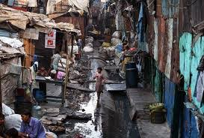
Operationalised through a Govt scheme of SLUM
Rajiv awas yojana (RAY) Targeted and reached through the following development of action:
Slum improvement
Slum upgrading
Slum redevelopment
Slum resettlement

Slide 10
Deprived child
A deprived child is a child under 18 years of age of who is not given proper parental care,control,education or other care and control necessary for the physical and emotional well being of the child .
the term may also refer to a destitute , homeless or abandoned child

Slide 11
Deprived child means a child
Who is for any reason destitute or abandoned
Who does not have the proper parental care
Who has been abused , neglected or is dependent
Whose home is an unfit place for the child by reason of depravity on the part of the parent

Slide 12
Socially deprived girls dalit and tribal girls
In India dalits-officially known as scheduled castes-constitute 1/6 of the population.they are consistently discriminated against despite a constitutional ban on untouchability and the enactment of specific legislation including the protection of civil rights act 1955 and the scheduled caste and tribes (prevention of atrocities act 1989)

Slide 13
Problem faced by the SC/ST Dalit women
Children of dalit and tribal communities face a number of abuses. Ex: violence,sexual abuse
Discrimination against ST,SC children can be seen in evidence of the education system
Early marriage and pregnancy was widespread
They have meager purchasing power and have poor housing condition
Lack of malnutrition

Slide 14
Schemes for educational development of SC/ST
Opening residential school
Book bank scheme
Remedial coaching scheme
Hostels for girls and boys
Pre and post metric scholarships
SSA and RMSA
Navodaya & Kendriya vidyalaya-15%&7.5% seats reserved for sc/st
National institute of open schooling
Primary health centre

Slide 15
Abused child
Abused child refers to a child whose health or welfare is harmed or threatened by his/her parent ,guardian of the child or the person exercising custodial control or supervision of the child
Child abuse can be single incident or number of different accident that take place over time

Slide 16
Child protection act 1999
Harm is defined as any determined effect of a significant nature on the childs wellbeing (sec 9 of the child protection act 1999)
2008 -children affected by substance abuse are considered as children in need of care and protection under the juvenile justice act 2000
India has launched an integrated child protection scheme which aim at shielding children from violence and abuse

Slide 17
Four different types of child abuse
Physical abuse - Hitting , buning,biting,shaking
(28.3% of adults report being physically abused )
Sexual abuse - Rape, incest, child prostitution
(20.7% of adults report being sexually abused )
Emotional abuse- Rejection, yelling ,criticism
(10.6% of adults report being emotionally abused )
Neglect abuse - Housing , healthcare , food,
(below 3% of adults report being neglect abused )

Slide 18
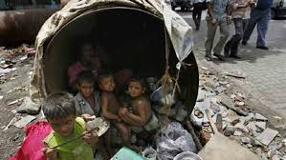
Street children
Street children is a term for children experiencing homelessness who are living on the streets of a city, town or villages. homeless youth are often called street kids and street youth ( 30% Disable children are street children)
UNICEF defined 3types of street children
Street living children
Street working children
Children from street families

Slide 19
WHO-Classifies street children according to 4 categories
Children who live in the street
Children who have left their families and resides in street
Children living in protection centre's or orphanages who are at risk of becoming homeless
Children who have week or insubstantial relations with their families

Slide 20
Characteristics of childhood of street children
Problem of social adaption
Feeling of social insecurity
Delayed language development
Lack of self –confidence due to backwardness
Problem in the development of moral values
Delayed physical development due to poverty

Slide 21
Child labour
Child means a persons who has not completed his 14 years of age any such person engaged for wages whether in case or kind is a child worker according to UNICEF all the children not being provided education at a school are considered as child labour
Legal definition of a child
- Article 45 of the constitution of India defines child as a person younger than 14 years
- Mines act -1952 says that a child is a person not older than 16 years

Slide 22
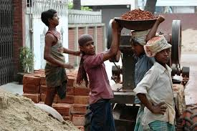
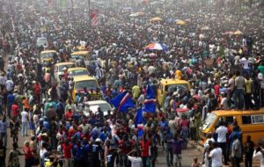
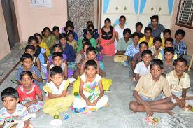
Causes of child labour
Bonded child
Over population
Illiteracy
Poverty
Urbanisation
Orphans
Unemployment of elders

Slide 23
Social measures of child labour
The workmens compensation act-1923
The industrial dispute act- 1947
Child minimum wages act- 1948
The employment state insurance act -1948
The coalmine provision act-1952
The contract labour act -1970
Child and adolescent labour- 1986

Slide 24
Child growing up poverty
A condition that puts a lot of children at risk for many of the issues listed in this section is poverty access to basic requirement such as food, shelter and clothing are the underlying cause of poor child health, child nutrition,child labour, child marriage and various other issues

Slide 25
Prime Causes of poverty
Poor and unemployed parents
Street children
Lack of education
Lack of social services
Disability
Discrimination
Effcets- poor physical health,mental health problem,low sense of well being,underachieving at school, social deprivation

Slide 26
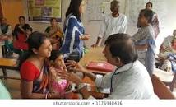
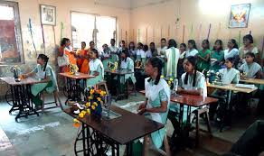
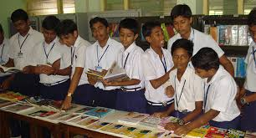
Removing and suggestion to poverty
Adequate nutrition
Clean drinking water
Sanitation facilities
Healthcare facilities
Education
Earning while learning
Vocational training

Slide 27
WAY TO MEASURES OF POVERTY
Planning commission 2004-05 estimated NSSO
The Arjun sengupta report
The saxena committee report
The tendulkar committee report -2009

Slide 28
Measure to promote the status of marginalized Children
Free and compulsory education to all
Creating an inclusive school
Providing special reservation quota
Providing basic amenities like water, nutrition food,transport , sanitary facility
Life enrichment programme
Financial assistance for remedial coaching
Establishment of residential schools

Slide 29
Teachers should develop a better relationship with community, NGO’s and Govt
Creating alternative school
Use school complex at all level
Vocational education and training for skill development
Grand-in-aid to voluntary organisation
Social development programmes for minorities

Slide 30
TNTEU-Model questions
1.Who are marginalized children? suggest measures to promote the status of marginalized children
2.Elaborate the different types of marginalized children and suggest measures to promote the status of marginalized children.
3.List the problem faced by the children living in slum areas and state your suggestion to rectify it.
Thank you
Thank you

